Slide 1
Industrial Controls data
Inputs and outputs

Slide 2
I/o types
Digital
Analog
Specialty

Slide 3

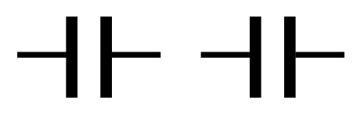
Digital iNputs
Digital OUTputs
Applications:
Contact Status
Pulse Counting (Metering)
Digital Status Communication
Considerations:
High/Low-Speed
Voltage Rating
Current Rating
Input Wetting
Applications:
Direct Switching Control
Interaction with ‘dumb’ Systems
Digital Status Communication
Considerations:
High/Low-Speed
Voltage Rating
Current Rating
Wetted Outputs
Default State

Slide 4
Analog iNputs
analog OUTputs
Applications:
Analog Metering
Environment Sensing
Control Input
Considerations:
Sampling Rate
Voltage Rating
Current Rating
Input Wetting
Sensor Type (V/I)
Applications:
Setpoint Control
Environment Control
Considerations:
Update/Control Rate
Voltage Rating
Current Rating
Output Type (V/I)

Slide 5
Specialty iNputs - RTD

Slide 6
Specialty iNputs - Thermocouple

